Slide 1

The XGBoost Algorithm and
Forest Cover Type Dataset
Matthew Brigham
Matthias Quinn
STA 685
Fall 2021

Slide 2
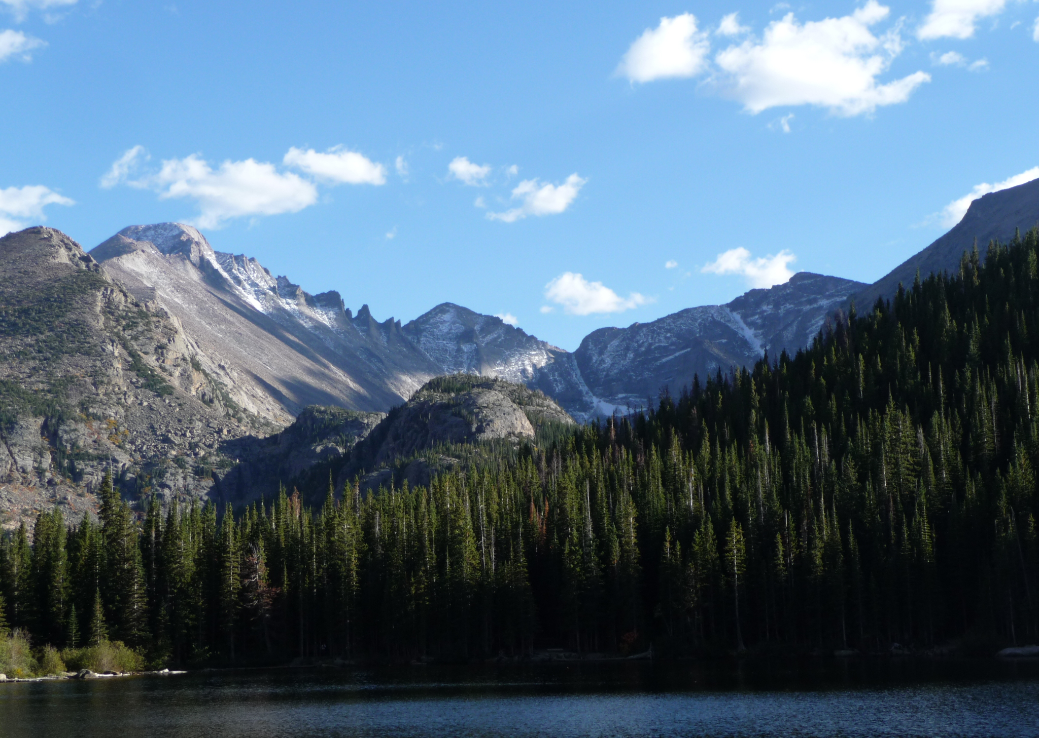
Presentation Outline
Review of Background Information
Decision Trees
Boosting
Introduction of XGBoost
Advantages Over Other Boosting Algorithms
The Algorithm
Application: Forest Cover Type Dataset

Slide 3
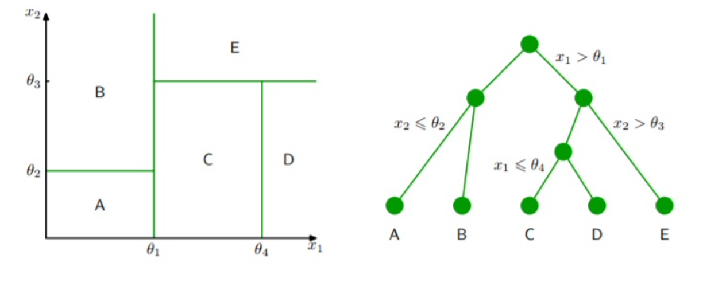
Decision Trees
A tree-like model where each internal node represents a decision on each feature
Branches represent the outcome of these decisions
Allows for both categorical and numeric features
Easy to interpret, but prone to overfitting
Improvements: Bagging, Boosting, and Random Forest
Image: Karlicek, O. (2021). Application of Machine Learning in Portfolio Construction (thesis). Charles University.
Refer to pgs 4-6 of handout

Slide 4
Boosting
Boosting is a general concept that can be applied to any statistical learning model
Boosting uses an ensemble of weak-learning decision trees to sequentially improve upon a base model
Weak learners are fit the residuals
Boosting can have high accuracy, but is usually very slow
There are several algorithms to implement boosting:
AdaBoost
Gradient Boosting
XGBoost
Refer to pgs 7-8 of handout
Notes:
Weak learners are shallow decision trees fit to the residuals, so it sequentially learns from its errors.

Slide 5
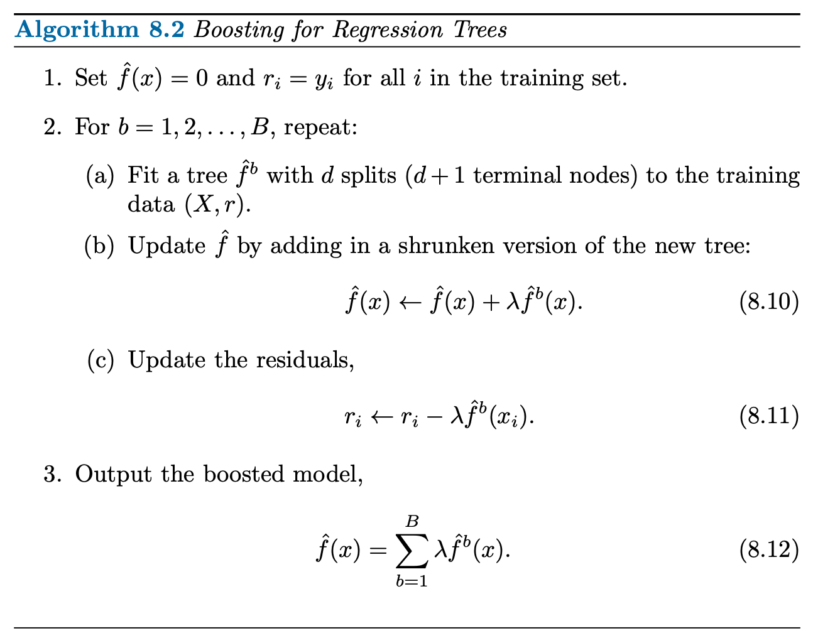
Boosted Regression Trees Algorithm
Three Parameters:
B - Number of additive trees
λ - Shrinking parameter
Usually a small, positive number
Learning rate
d - Number of splits in each shallow tree
Controls the complexity
Gareth James, Daniela Witten, Trevor Hastie, Robert Tibshirani. (2013). An introduction to statistical learning : with applications in R. New York :Springer
Refer to pgs 7-8 of handout

Slide 6
What is XGBoost?
History of XGBoost
It stands for “Extreme Gradient Boosting”
Boosting algorithm designed for speed
Designed for efficiency, flexibility, and portability
An implementation of machine learning algorithms
Created by Tianqi Chen in 2014 at the University of Washington [1]
Part of Chen’s Ph.D research
Has dominated Kaggle competitions
Currently available in seven programming languages, including R [2]
Chen, T., & Guestrin, C. (2016). XGBoost. Proceedings of the 22nd ACM SIGKDD International Conference on Knowledge Discovery and Data Mining. https://doi.org/10.1145/2939672.2939785
What is XGBoost? NVIDIA Data Science Glossary. (n.d.). Retrieved December 9, 2021, from https://www.nvidia.com/en-us/glossary/data-science/xgboost/.
Refer to pgs 9-13 of handout

Slide 7
XGBoost Algorithm Highlights
Regularized loss function
Helps prevent overfitting
Incorporates multiple splitting algorithms
XGBoost can be applied to a variety of datasets
Utilizes second-order gradients to optimize the loss function quickly
Utilizes all computer system’s hardware optimally
Uses computer memory and hardware optimally for efficient computation and data retrieval
Refer to pgs 9-13 of handout

Slide 8
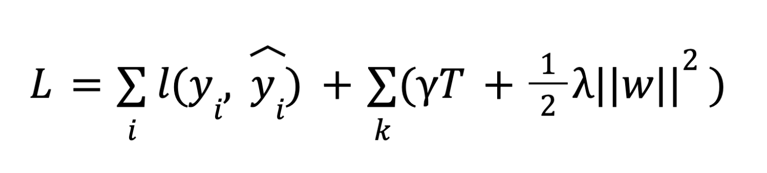
Regularized Loss Function for XGBoost
Common residual error
L1 penalty
L2 penalty
Utilizes L1 and L2 penalty/regularization, as seen with ridge and lasso for parameter estimation
It measures how predictive a model is with respect to the given training data
Regularization controls model complexity and prevents overfitting
Notice that when the regularization term is set to zero, the loss function becomes just the residual error (RSS)
Refer to pgs 9-13 of handout

Slide 9
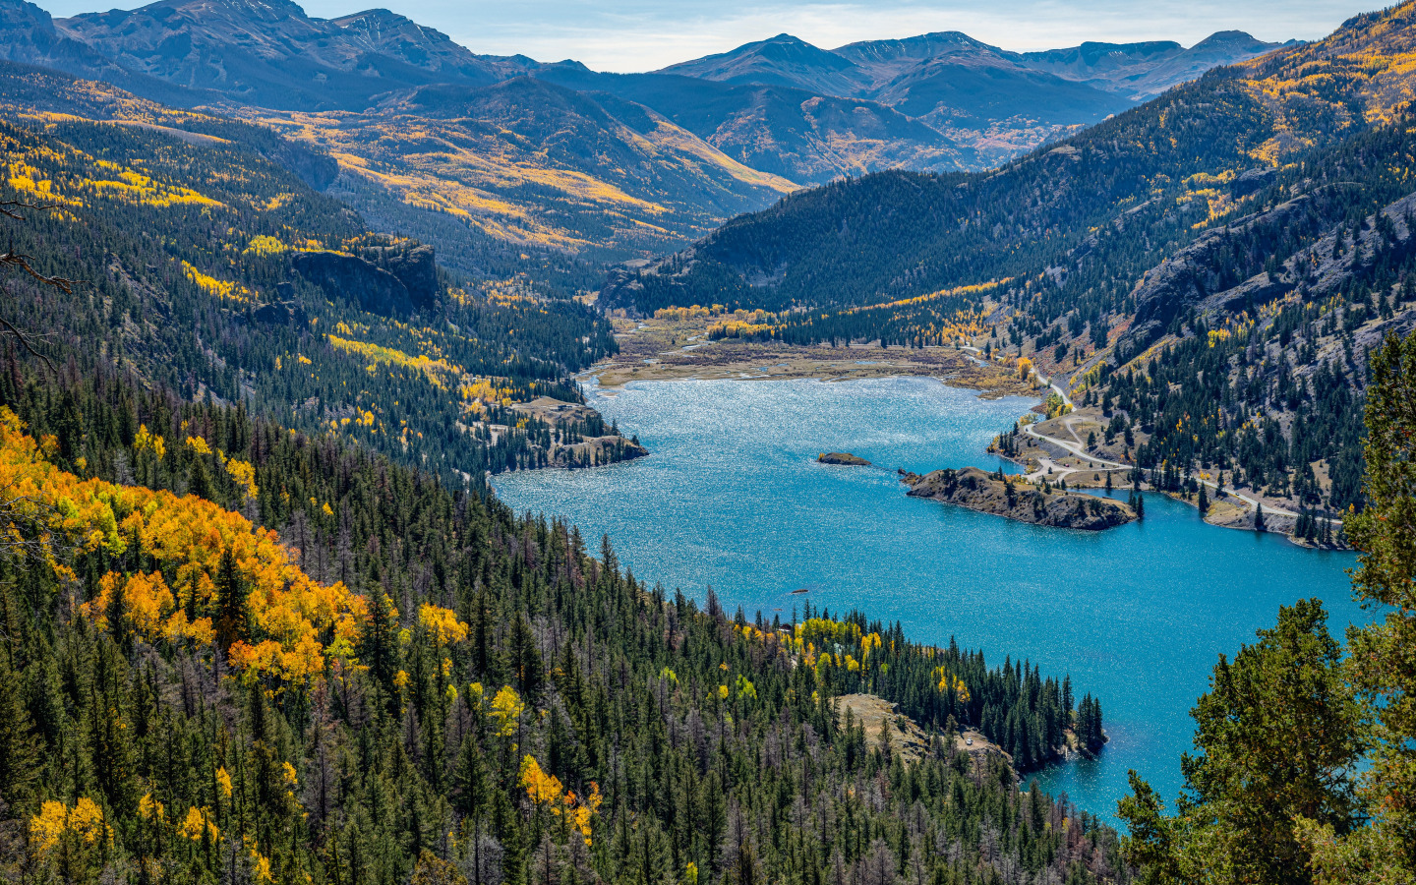
Application: Forest Cover Type Dataset
Can you predict what type of trees will grow on a parcel of land without using sensor data?
Data collected from 30 square meter parcels of land in different areas of Colorado, USA
7 different types of trees:
Spruce & Douglas Firs
Lodgepole & Ponderosas Pines
Cottonwood/Willow
Aspen
Krummholz
13 variables after re-coding
Data: Blackard, J. A., Dean, D. J., & Anderson, C. W. (1998). https://archive.ics.uci.edu/ml/datasets/covertype.
Refer to pg 13 of handout
Notes:
4 Wilderness areas that vary by size and elevation, among other variables

Slide 10
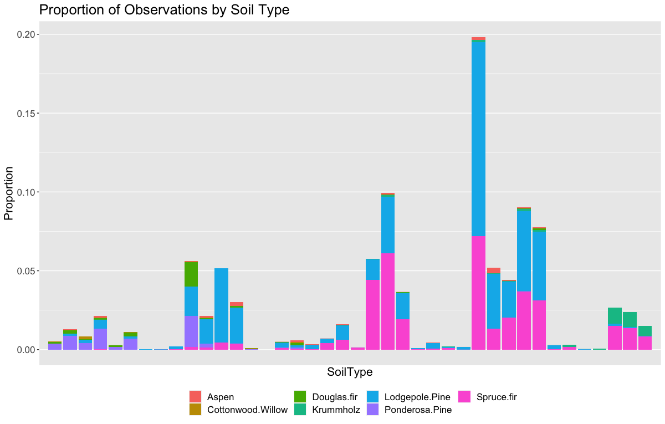
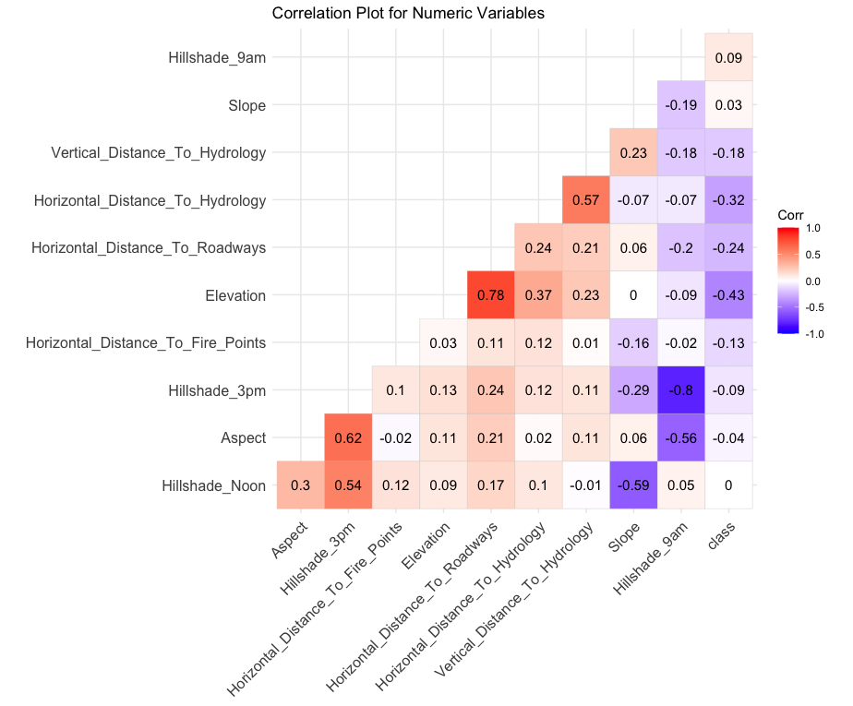
Forest Cover Type: Exploratory Analysis
Refer to pgs 13-20 of handout

Slide 11
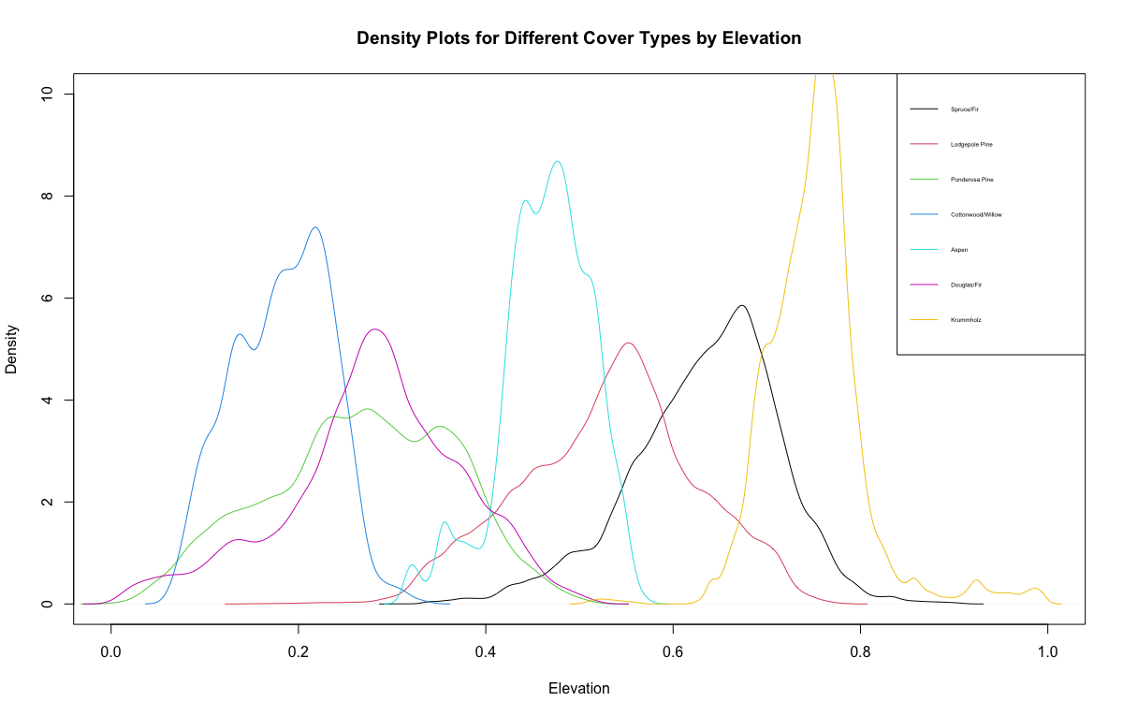
Forest Cover Type: Exploratory Analysis
Refer to pgs 13-20 of handout
Notes:
Best separation among variables - elevation.

Slide 12
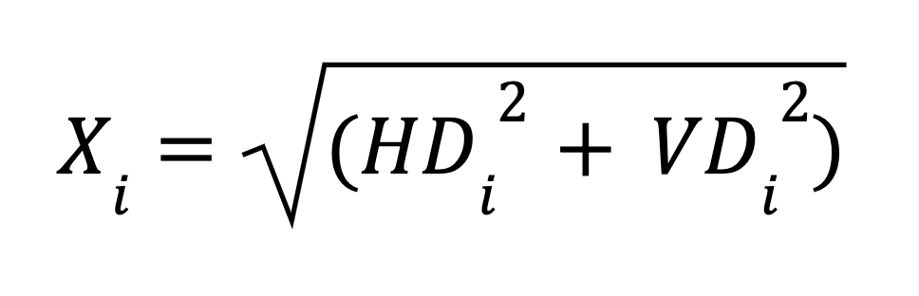
Feature Engineering and the Train/Test Split
Euclidean distance to hydrology:
88% of the data belong to two cover types
May lead to biased results, like accuracy
Balanced random sample:
32,197 training observations
5000 observations per cover type
80/20 split for Cottonwood/Willow
548,815 test observations
Class | Cover Type | Frequency | Relative Frequency
1 | Spruce/fir | 211840 | 0.365
2 | Lodgepole Pine | 283301 | 0.488
3 | Ponderosa Pine | 35754 | 0.062
4 | Cottonwood/Willow | 2747 | 0.005
5 | Aspen | 9493 | 0.016
6 | Douglas/fir | 17367 | 0.03
7 | Krummholz | 20510 | 0.035
Refer to pg 20 of handout

Slide 13
Model Setup
Variable Name | Measurement Unit | Description
Elevation | Meters | Elevation in Meters
Aspect | Azimuthal Angle | Aspect in Degrees Azimuth
Slope | Degrees | Slope in Degrees
Horizontal Distance to Hydrology | Meters | Horizontal distance to nearest surface water features
Vertical Distance to Hydrology | Meters | Vertical distance to nearest surface water features
Horizontal Distance to Roadways | Meters | Horizontal distance to nearest roadway
Hillshade 9 AM | 0-255 Index | Hillshade index at 9 AM, during summer solstice
Hillshade Noon | 0-255 Index | Hillshade index at noon, during summer solstice
Hillshade 3 PM | 0-255 Index | Hillshade index at 3 PM, during summer solstice
Horizontal Distance to Fire Points | Meters | Horizontal distance to nearest wildfire ignition points
Wilderness Area | 0 (absent), 1 (present) | Wilderness area designation
Soil Type | 0 (absent), 1 (present) | Soil type designation
Euclidean Distance to Hydrology | Meters | Euclidean distance to nearest surface water features
Cover Type | 1 to 7 | Forest cover type designation
Models used:
LDA
KNN
Multinomial Logistic Regression
Decision Tree
XGBoost
Metrics used:
AUC
Accuracy
Time to compute
Dependent Variable:
Cover Type
Refer to pg 21 of handout

Slide 14
Model Results
Model | AUC | Accuracy | Time (sec)
LDA | 0.93 | 0.635 | 23.16
KNN (k=5) | 0.97 | 0.821 | 360.53
Multinomial Log. Regression | 0.94 | 0.679 | 505.57
Decision Tree | 0.87 | 0.553 | 35.53
XGBoost | 0.98 | 0.868 | 3.07
XGBoost outperformed all other models in terms of accuracy and time to compute
Other models clearly exhibit the trade-off between accuracy and computation time
Refer to pg 22 of handout

Slide 15
Variable Importances
Feature | Gain | Cover | Frequency
Elevation | 0.35257 | 0.42363 | 0.14353
Soil Type | 0.28779 | 0.13321 | 0.08592
Horizontal Distance To Roadways | 0.08601 | 0.09694 | 0.17689
Horizontal Distance To Fire Points | 0.07676 | 0.09432 | 0.1688
Hillshade 9am | 0.04415 | 0.03634 | 0.05896
Euclid Dist Hydro | 0.03438 | 0.03553 | 0.04818
Wilderness Area | 0.02854 | 0.05631 | 0.031
Aspect | 0.02102 | 0.02295 | 0.05964
Horizontal Distance To Hydrology | 0.01828 | 0.01179 | 0.05054
Hillshade Noon | 0.01706 | 0.02847 | 0.04885
Elevation and Soil Type are the most important variables
Have the greatest gain
Refer to pg 24 of handout

Slide 16
Comments XGBoost Limitations
Tree-based methods usually do not perform well for extrapolation [1]
Usually a problem for regression, not classification
Number of features exceeds the number of observations [2]
Hooker, G. (2004). Diagnosing extrapolation. Proceedings of the 2004 ACM SIGKDD International Conference on Knowledge Discovery and Data Mining - KDD '04. https://doi.org/10.1145/1014052.1014121
Gonzalez, R. (2018). More Features Than Observations [web log]. Retrieved from https://rodrigo-gonzalez.com/blog/featureselection.

Slide 17
Conclusion and Final Thoughts
XGBoost is a fairly recent algorithm (2014) and has gained a lot of popularity
XGBoost has been shown to predict the forest cover type data very well
It also outperformed other models in terms of accuracy and computation time
Can be applied to any data set type, not just tabular data

Slide 18
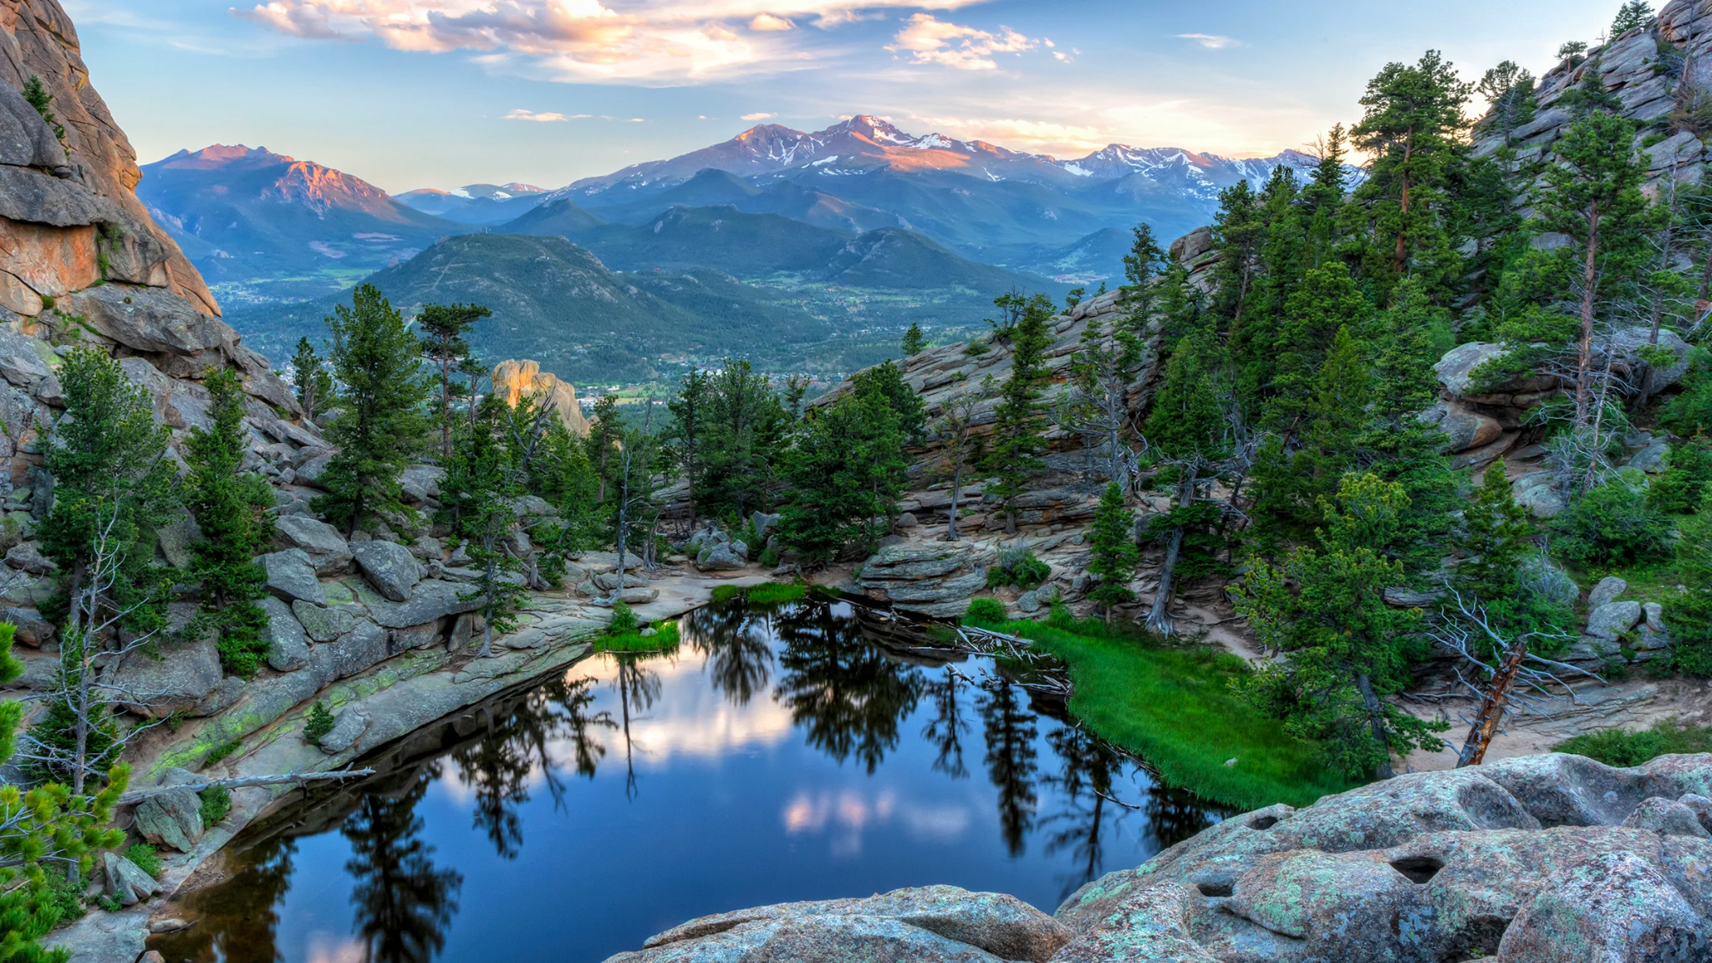
Questions?

